Slide 1
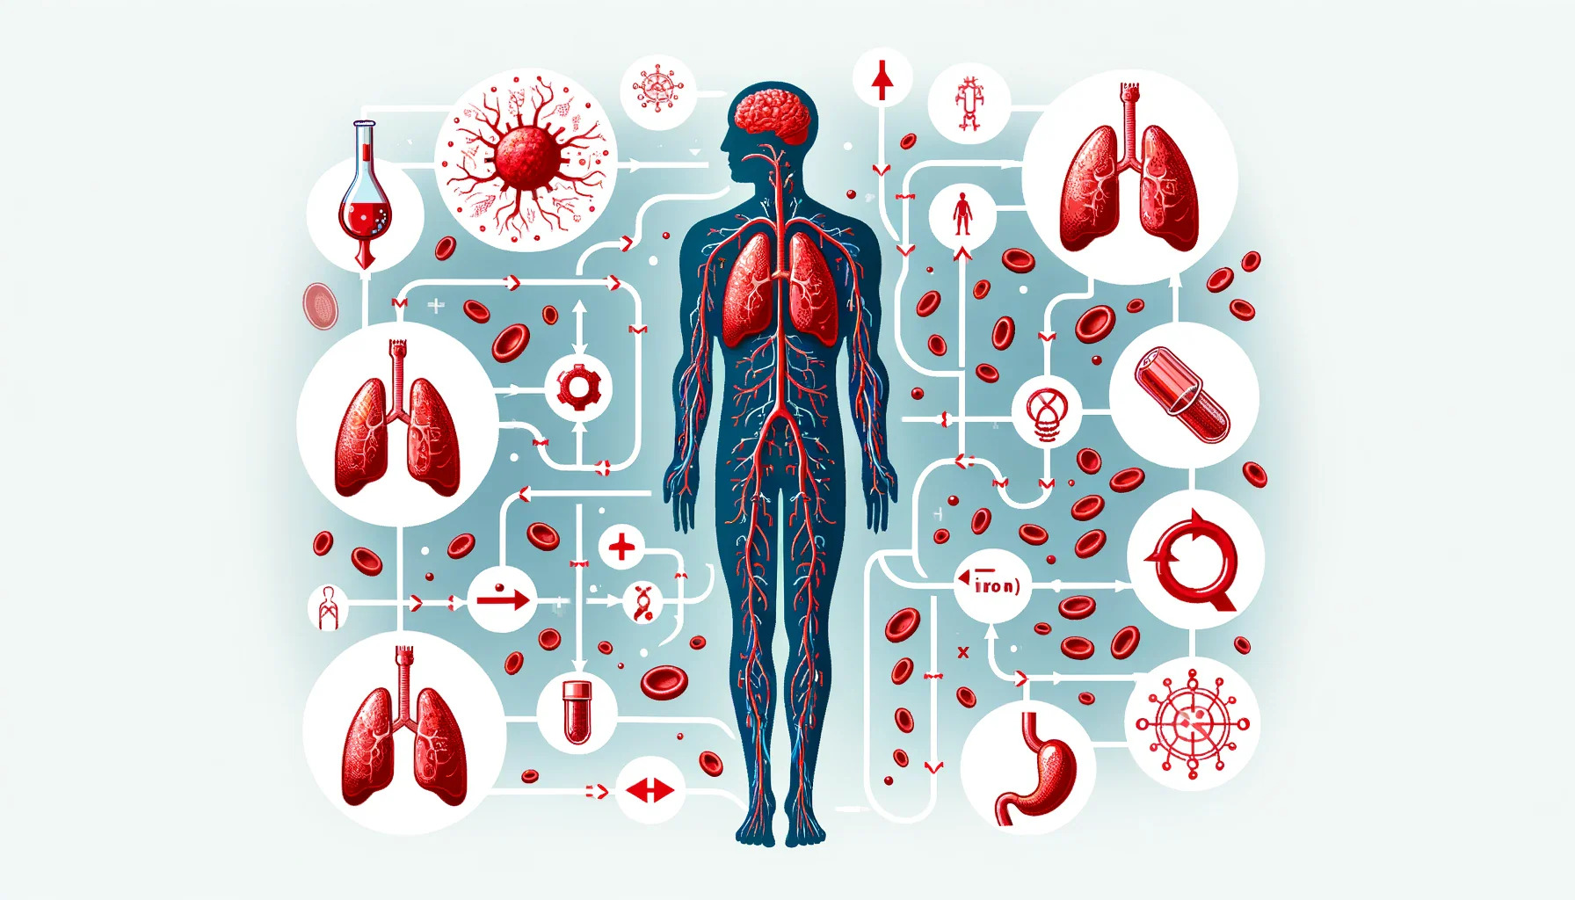
Iron Metabolism
Dr. Tripti Saxena
HOD & Professor

Slide 2
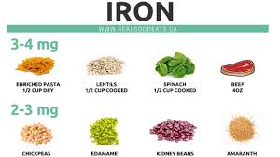
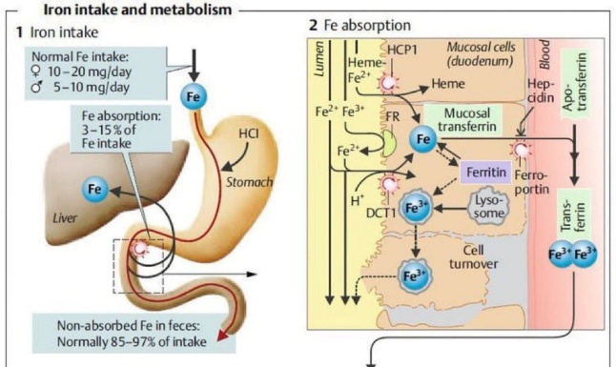
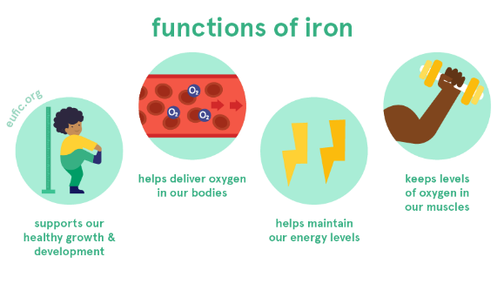
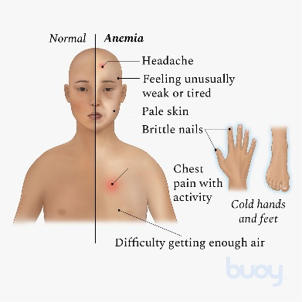
Specific Learning Objectives
Dietary sources of iron.
Absorption mechanism of iron.
Transport and metabolism of iron.
Biochemical functions of iron.
Associated Clinical disorders.

Slide 3
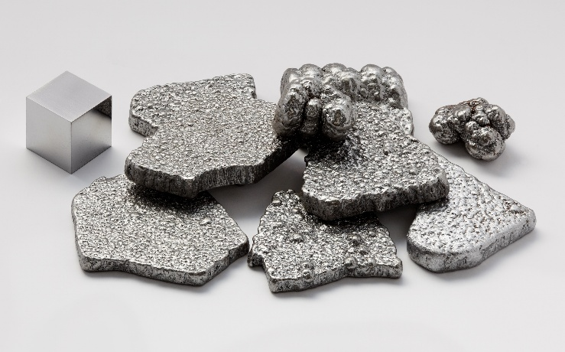
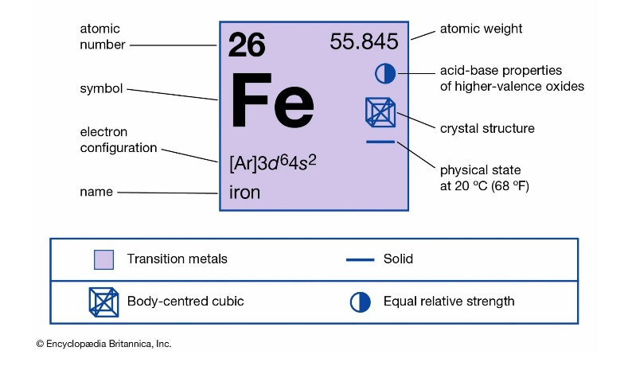
Iron
Micromineral/ Trace Mineral.
The daily requirement for trace minerals < 100 milligrams.
Ex. Fe, Zn, I, Se, Cu
Fe Mostly found in :
Hemoglobin - carrier of oxygen.
Myoglobin - protein in muscles, making oxygen available.
Cellular Respiration – Part of Fe-S complex in ETC.
Iron Containing enzymes - Catalase, Peroxidase.
Iron balance is critical --- one way.

Slide 4
Recommended Dietary Allowance (RDA)
Depends on Age, Gender, & life stage.
RDA : 10-30 mg.
Typical mixed diet, 10-15% of dietary iron is absorbed.
1-2 mg is absorbed.
Group | Iron RDA (mg/day)
Children (1-3 years) | 7
Children (4-8 years) | 10
Children (9-13 years) | 8
Adult Male | 8
Menstruating Female | 18
Pregnant Female | 27

Slide 5
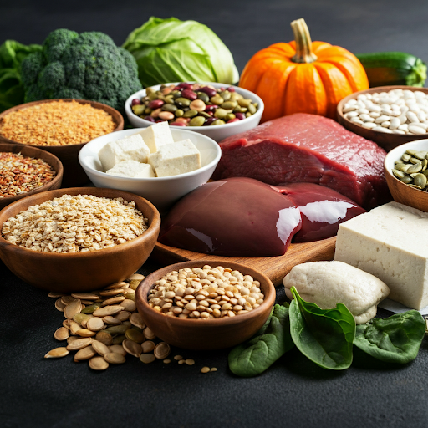
Dietary Sources
Heme iron (best absorbed): Oysters, clams, liver, red meat, Polutary, Fish.
Non-heme iron (needs help for absorption): Fortified cereals, legumes (lentils, beans), tofu, pumpkin seeds, Dark leafy green vegetables.
Animal sources: Generally, have more iron and it's easier to absorb.
Plant sources: Combine with vitamin C (like citrus fruits) for better absorption.

Slide 6
Factors that Hinder Iron Absorption:
Phytates, Polyphenols, High calcium intake, Antacids, Tannins, Certain medical conditions: Conditions like celiac disease or inflammatory bowel disease.
Factors that Promote Iron Absorption:
Vitamin C (ascorbic acid), Heme iron, Cooking: Cooking some vegetables can increase the amount of iron your body can absorb.

Slide 7
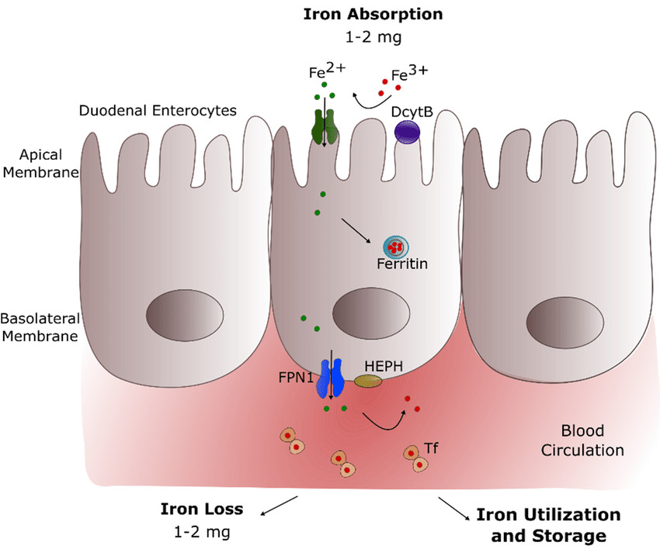
Iron Absorption
Iron absorption occurs in the duodenum and proximal jejunum of the small intestine, where enterocytes absorb iron through the apical membrane.
Iron absorption is a tightly regulated process, especially crucial since the human body lacks a mechanism to excrete excess iron.
1. Reduction of Iron:
Most dietary iron exists in the ferric (Fe3+) form, Duodenal cytochrome B (Dcytb), a ferrireductase enzyme reduces ferric iron to ferrous iron.

Slide 8
2. Transport across the Apical Membrane:
Divalent Metal Transporter 1 (DMT1): This protein, located on the apical membrane of enterocytes, is the primary transporter responsible for the uptake of ferrous iron.
DMT1 also transports other divalent metals like zinc, manganese, copper, etc., highlighting the need for regulation to prevent excessive uptake of any single metal.
3. Heme Iron Absorption:
Heme iron, found in animal products, is absorbed intact as a porphyrin ring complex.
Heme Carrier Protein 1 (HCP1): This protein facilitates the transport of heme across the apical membrane.
Once inside the enterocyte, heme is broken down by heme oxygenase to release iron.

Slide 9
4. Intracellular Iron Handling:
Once inside the enterocyte, iron enters a labile iron pool (LIP).
From the LIP, iron can have three fates:
Storage: Iron can be stored within ferritin, a protein complex.
Utilization: Iron can be used for metabolic processes within the enterocyte.
Transport: Iron can be transported across the basolateral membrane into the bloodstream.
5. Regulation of Iron Absorption:
Hepcidin: A hormone produced by the liver, hepcidin plays a central role in regulating iron absorption. When iron levels are high, hepcidin production increases, leading to the degradation of ferroportin, the protein responsible for exporting iron from enterocytes. This reduces iron absorption.
Iron status: The body's iron stores influence absorption. When iron stores are low, absorption efficiency increases.

Slide 10
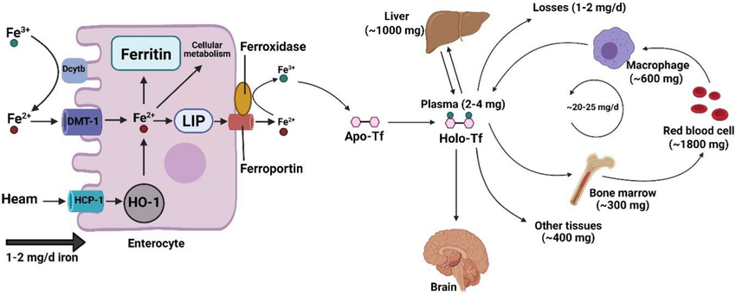
DMT1, Divalent metal transporter 1; HCP1, heme carrier protein 1; LIP, labile iron pool; Apo-Tf, apo-transferrin; Holo-Tf, holo-transferrin; HO-1, heme oxygenase-1; Dcytb, duodenal cytochrome B. This Figure was created by BioRender (https://biorender.com/)
Iron metabolism and homeostasis

Slide 11
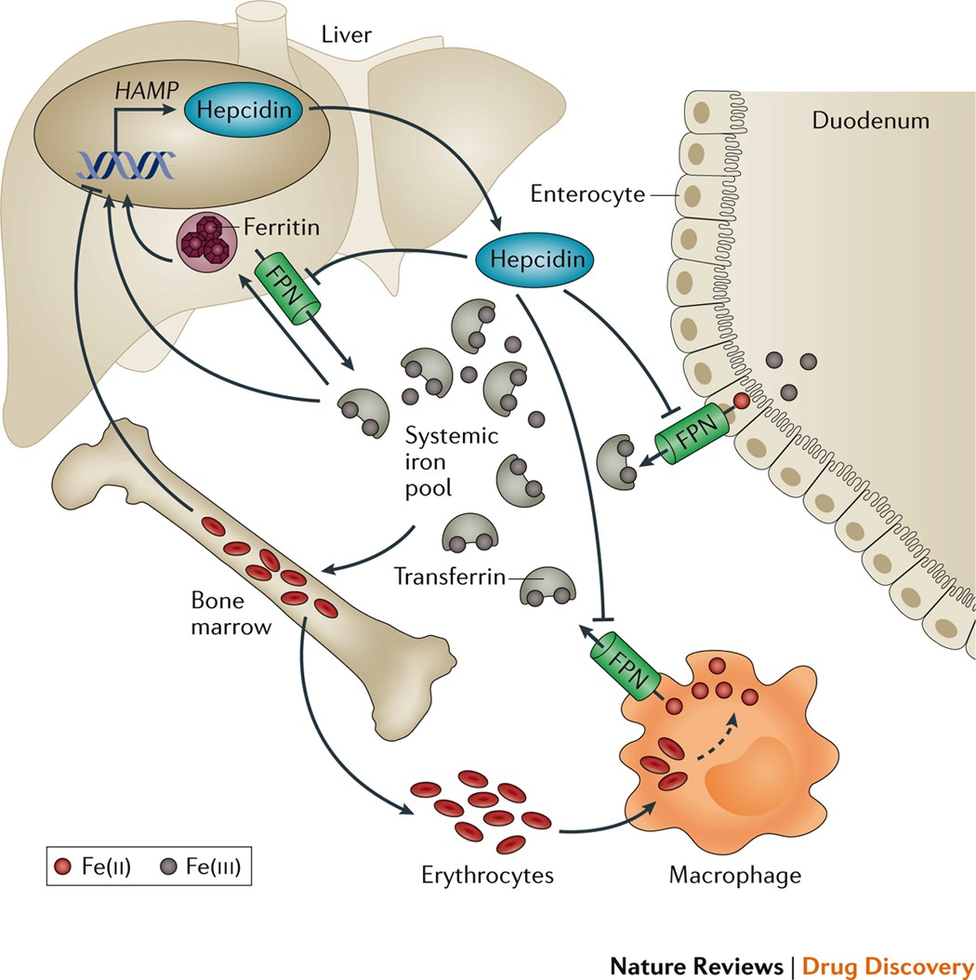

Slide 12
What is Mucosal block theory!!
Iron homeostasis is regulated strictly at level of intestinal absorption. The Mucosal Block theory basically says that a large dose of iron can temporarily "block" your gut from absorbing more iron for a few hours or days. It's like your intestines get full of iron and need time to process it before they can take in more.
Think of it like this: imagine a sponge. When you first pour water on it, it soaks it up quickly. But once it's saturated, it can't absorb more water until it's squeezed out.

Slide 13
Transport in the Blood
Transferrin: A beta -globulin protein that binds to ferric iron (Fe3+) and transports it in the bloodstream.
Each transferrin molecule: Can carry two iron ions.
Transferrin saturation: Indicates the percentage of transferrin binding sites occupied by iron.
Transferrin receptors (TfR): Present on the surface of cells, they bind to iron-loaded transferrin.
Endocytosis: The TfR-transferrin complex is internalized into the cell within a vesicle.
Iron release: Inside the vesicle, iron is released from transferrin due to the acidic environment.
Recycling: The TfR and transferrin are recycled back to the cell surface.

Slide 14
Storage
Ferritin: This is the primary iron storage protein found in most cells. It's a soluble protein complex that can store thousands of iron atoms in its core.
Hemosiderin: This is a less readily available storage form of iron. It's an insoluble complex that forms when there's an excess of iron that exceeds the storage capacity of ferritin.
Major Storage Site: Liver, spleen, and bone marrow.

Slide 15
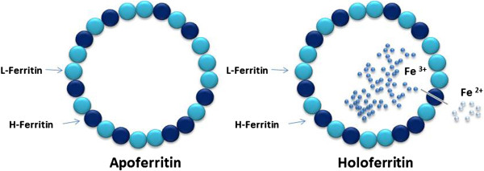
Ferritin
A large, spherical protein complex, 24 subunits that form a hollow shell.
Stores iron in a safe, bioavailable, and non-toxic form, release iron in a controlled manner when needed. Prevents free iron from generating harmful free radicals.
Each ferritin molecule can store ferric (Fe3+) form up to 4500 iron atoms within its hollow core, as a mineralized ferrihydrite core within ferritin.
Predominantly found within cells, in the cytoplasm, of various tissues.

Slide 16
Feature | Transferrin | Ferritin
Nature | Glycoprotein (protein with carbohydrate) | Protein complex (24 subunits)
Location | Blood plasma, extracellular fluid | Primarily intracellular (within cells)
Primary Function | Iron transport | Iron storage
Iron Binding | Binds 2 ferric iron ions (Fe3+) | Stores up to 4500 ferric iron atoms (Fe3+)
Regulation | Primarily regulated by iron levels and EPO (erythropoietin) | Primarily regulated by iron levels and inflammatory stimuli
Clinical Significance | Transferrin saturation and TIBC (total iron-binding capacity) are used to assess iron status | Serum ferritin levels are used to assess body iron stores

Slide 17
Regulation of Transferring and Ferritin
Transferrin Regulation
Low iron: Iron Regulatory Proteins (IRPs) bind to Iron-Responsive Elements (IREs) located in the 3' untranslated region (UTR) of transferrin mRNA. This binding stabilizes the mRNA, increasing its lifespan and leading to more transferrin protein synthesis.
High iron: When iron levels are high, IRPs detach from the IREs. This destabilizes the transferrin mRNA, making it susceptible to degradation and reducing transferrin protein production.
Ferritin Regulation
Low iron: IRPs bind to IREs located in the 5' UTR of ferritin mRNA. This binding blocks the translation of the mRNA, reducing ferritin protein synthesis.
High iron: IRPs detach from the IREs, allowing the translation of ferritin mRNA to proceed, leading to increased ferritin protein production.

Slide 18
Post-transcriptional regulation of ferritin and transferrin receptor (TfR) by iron regulatory proteins (IRPs).

Slide 19
Clinical Significance
Iron Deficiency
Iron Deficiency Anemia
Restless Legs Syndrome (RLS)
Impaired Cognitive Function
Impaired Immune Function
Pica
Koilonychia
Iron Excess
Hereditary Hemochromatosis
Secondary Hemochromatosis
Liver Disease (hepatitis, cirrhosis, liver cancer)
Heart Problems (heart failure, arrhythmias)
Diabetes
Arthritis
Skin Pigmentation

Slide 20
Iron Deficiency Anemia
Most common type of anemia: Affects millions worldwide, especially women, children, and people with poor diets.
Cause: Insufficient iron to produce hemoglobin, the oxygen-carrying protein in red blood cells.
Symptoms: Fatigue, weakness, shortness of breath, pale skin, dizziness, headache, cold hands/feet.
Diagnosis: Blood tests (low hemoglobin, hematocrit, ferritin, and MCV)

Slide 21
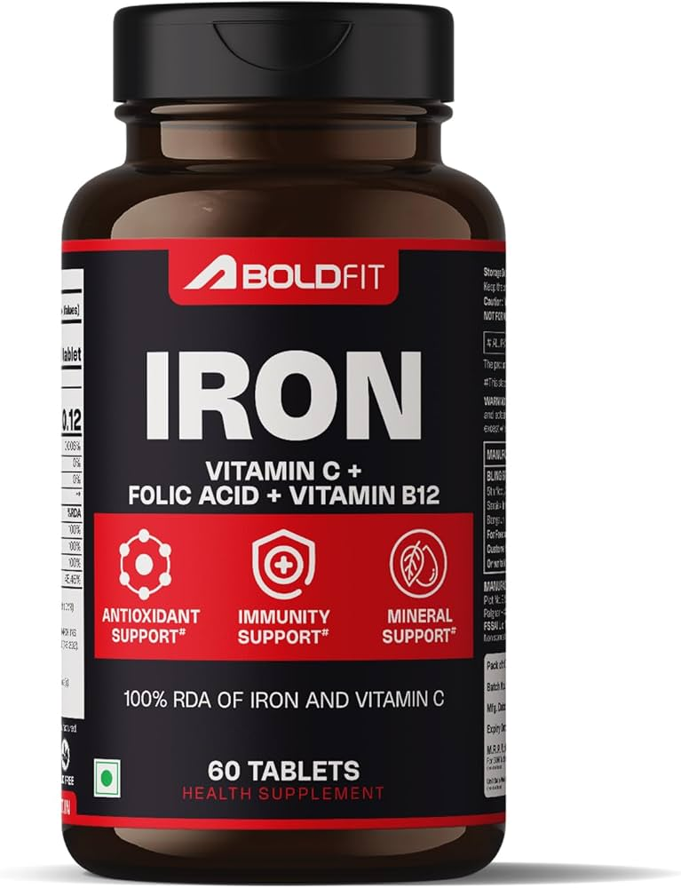
Iron Deficiency Anemia
Treatment: Iron supplements, dietary changes (iron-rich foods, vitamin C), addressing underlying causes (blood loss).
Prevention: Balanced diet, iron-rich foods, adequate iron intake for those at risk (pregnant women, growing children).
Complications (if untreated): Heart problems, developmental delays in children, pregnancy complications.

Slide 22
Hemochromatosis
Iron Overload: The hallmark of hemochromatosis is excessive iron accumulation.
Genetics vs. Acquired: Hemochromatosis can be classified as primary (genetic) or secondary (acquired).
Symptoms: Often appear in mid-life and may include fatigue, joint pain, abdominal pain, liver enlargement, skin darkening ("bronze diabetes"), heart problems, and diabetes.
Diagnosis: Blood tests (serum ferritin, transferrin saturation, genetic testing), liver biopsy.
Treatment: Phlebotomy (regular blood removal) to reduce iron levels, iron chelation therapy (medication to remove iron), dietary changes.

Slide 23
Primary Hemochromatosis
Mutations in the HFE gene. Most common autosomal recessive, inherited disorder of iron overload
Increased Iron Absorption: The body absorbs more iron than it needs from the diet, leading to a gradual buildup of iron in various organs.
Iron Accumulation: Excess iron is primarily stored in the liver, heart, pancreas, joints, and skin.
Symptoms: Often appear in mid-life (40s-60s for men, later for women due to menstruation)
Fatigue, weakness, Joint pain, Abdominal pain, Liver enlargement (hepatomegaly), Skin darkening (bronze diabetes), Heart problems (cardiomyopathy, arrhythmias), Diabetes (pancreatic damage)

Slide 24
Diagnosis:
Blood tests: elevated serum ferritin, elevated transferrin saturation, genetic testing for HFE mutations
Liver biopsy: to assess iron deposition and liver damage
Treatment:
Phlebotomy (therapeutic blood removal): the mainstay of treatment, aims to reduce iron levels.
Iron chelation therapy: medication to remove iron, used if phlebotomy is not tolerated.
Dietary modifications: avoiding iron-rich foods and vitamin C supplements.

Slide 25
Secondary Hemochromatosis
Acquired: Not genetic; results from other conditions.
Iron Overload: Excess iron comes from sources like: Frequent blood transfusions, Increased red blood cell breakdown (hemolysis), Liver disease etc.
Organ Damage: Can affect various organs, including the liver, heart, and pancreas.
Symptoms: Variable; depend on the cause and affected organs. May include fatigue, joint pain, and skin darkening.
Diagnosis: Blood tests (ferritin, transferrin saturation), liver biopsy, and evaluation of underlying conditions.
Treatment: Treat the root cause (e.g., manage anemia, reduce transfusions). Iron chelation therapy (if needed to remove excess iron).

Slide 26
Feature | Hemochromatosis | Hemosiderosis
Iron Overload | Systemic (whole body) | Localized (specific areas)
Cause | Mostly genetic | Usually due to bleeding or other conditions
Absorption | Increased (primary form) | Normal
Organs | Liver, heart, pancreas | Lungs, skin, liver, spleen
Treatment | Remove excess iron | Treat the underlying cause

